Slide 1

Big Data Application Project
Analysis of Cafe Brands and Companies Data
1615008 김소림
1615009 김소현
1615049 이서라

Slide 2

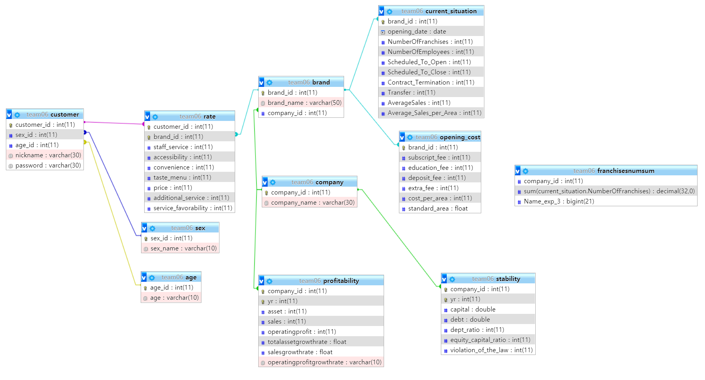
Database

Slide 3
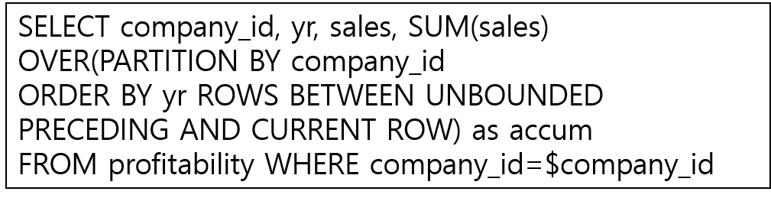
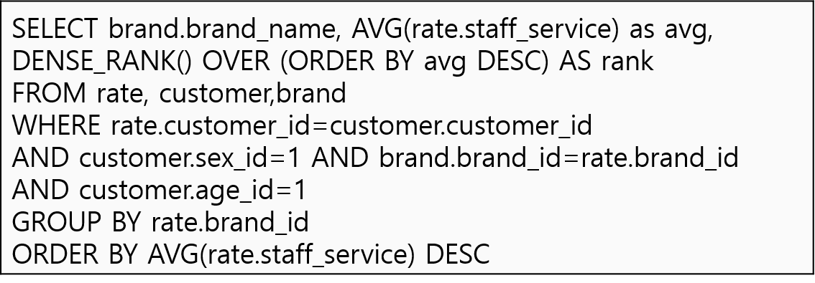
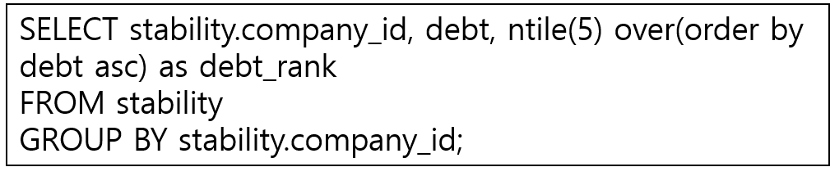
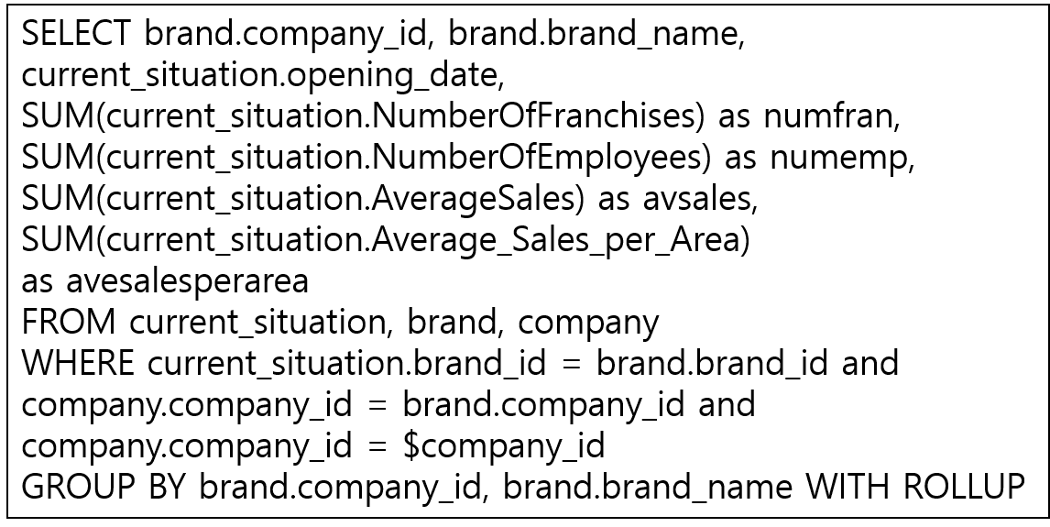
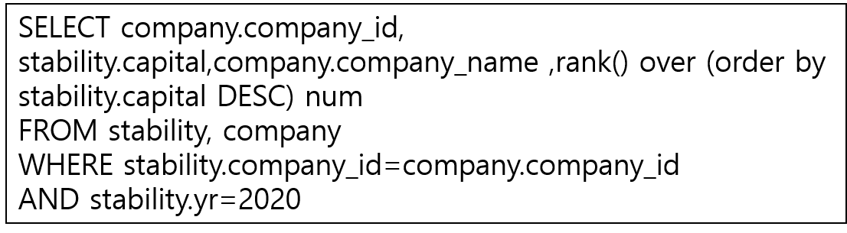
5 Advanced Queries
1. Windowing
4. DENSE RANK
2. NTILE
5. ROLL UP
3. RANK

